Slide 1
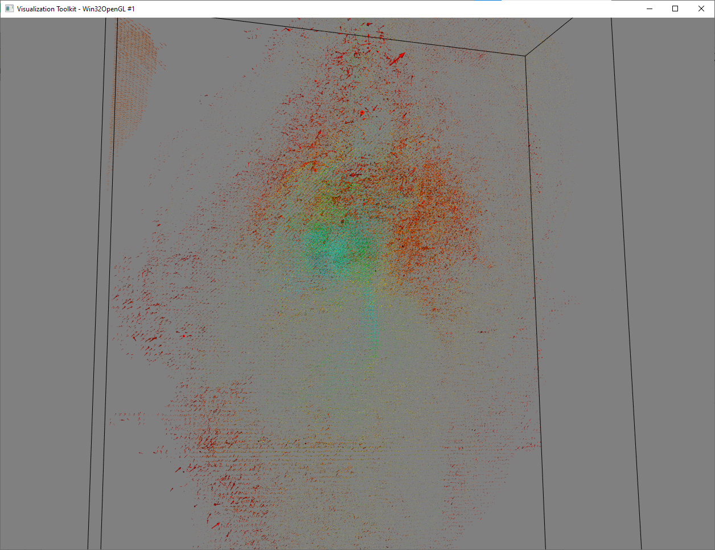
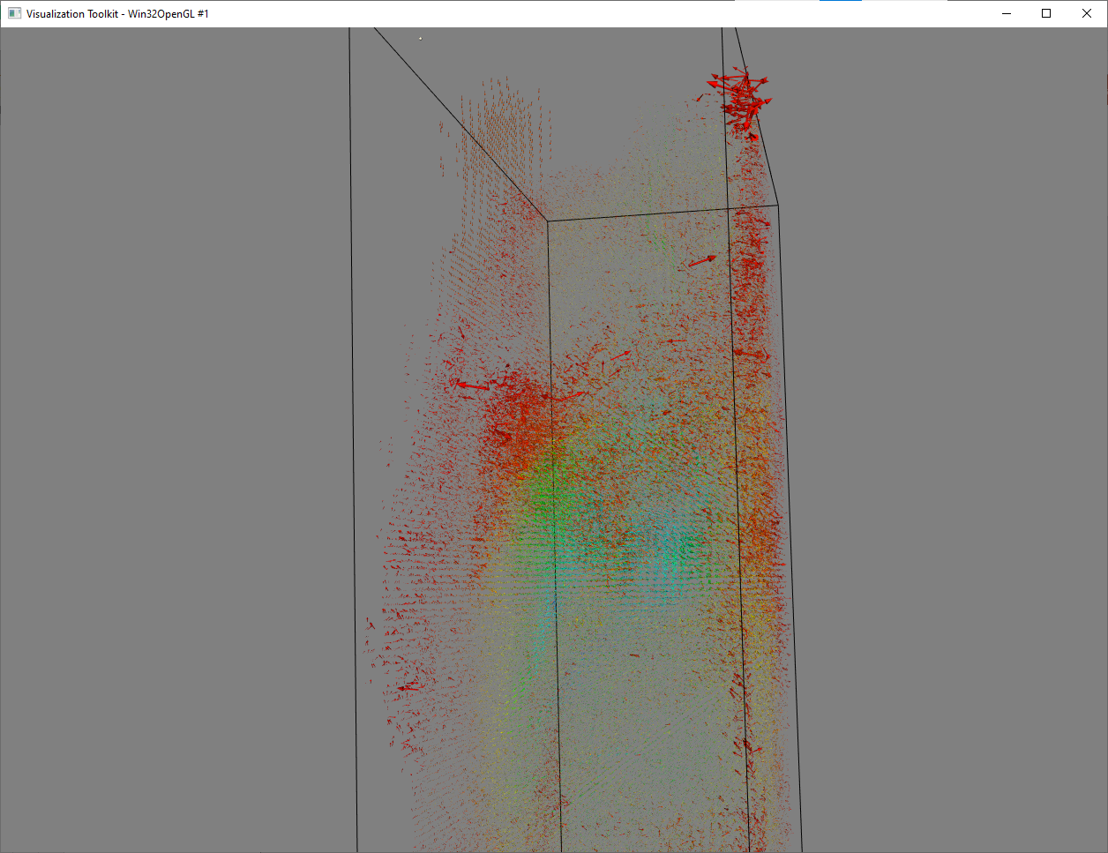
Color: mag_struct.mat, Vector: vel_struct.mat
@ t=0
glyph.SetScaleFactor(10)

Slide 2
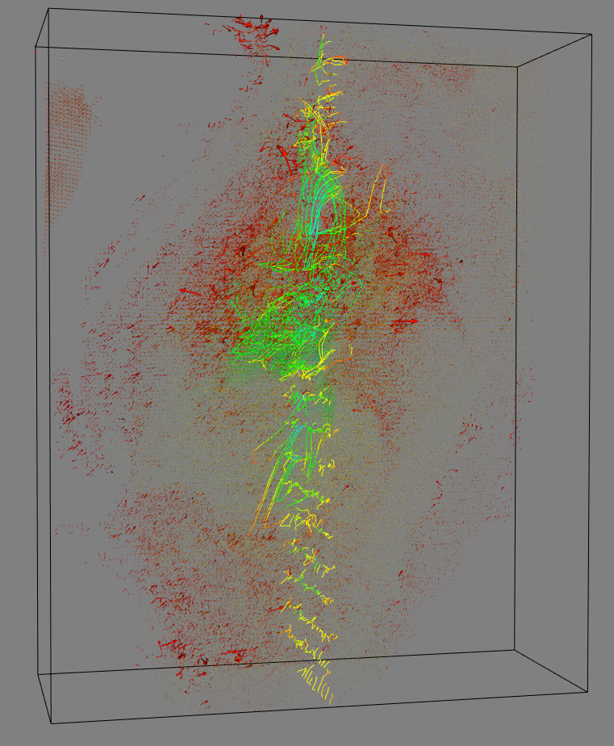
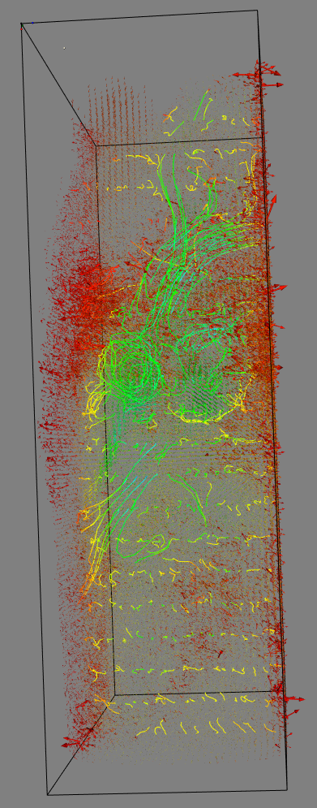
Draw pathlines from Sagittal plane
Start from t=0

Slide 3
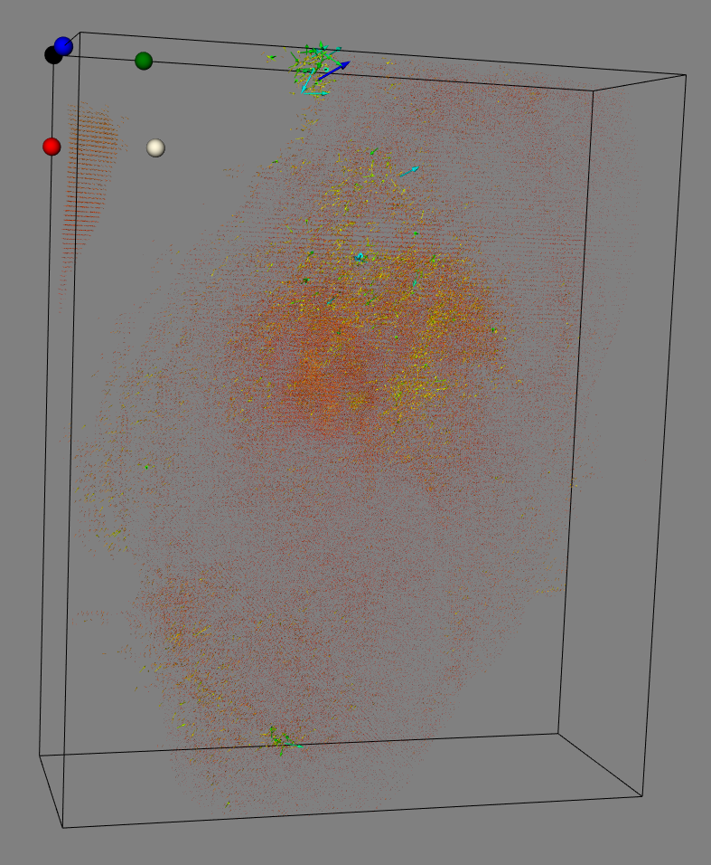
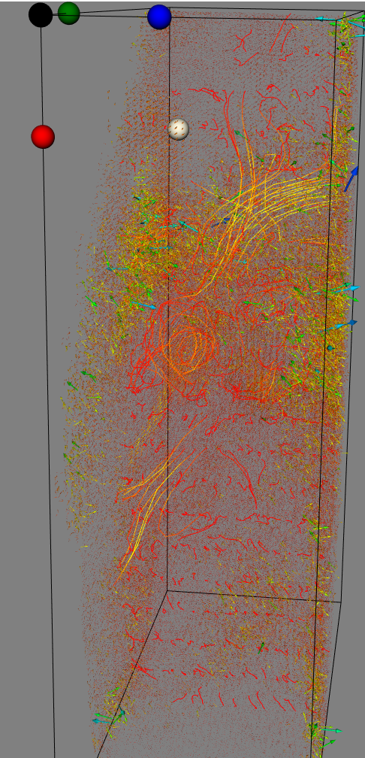
Color: speed (rms), Vector: vel_struct.mat
@ t=0

Slide 4
Further work
Apply mask to emphasize the intended area
Plane widget to assign source plane
Start from specified time point
Repeat the first time-frame at the end of the sequence (add one more phase)
Get specified time frame data to draw vector plot

Slide 5
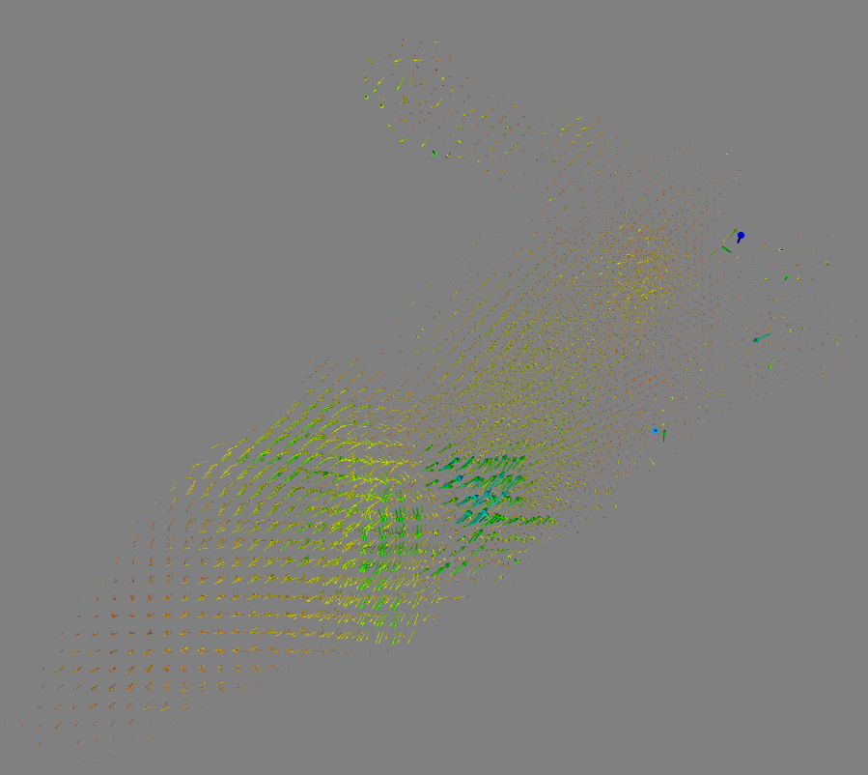
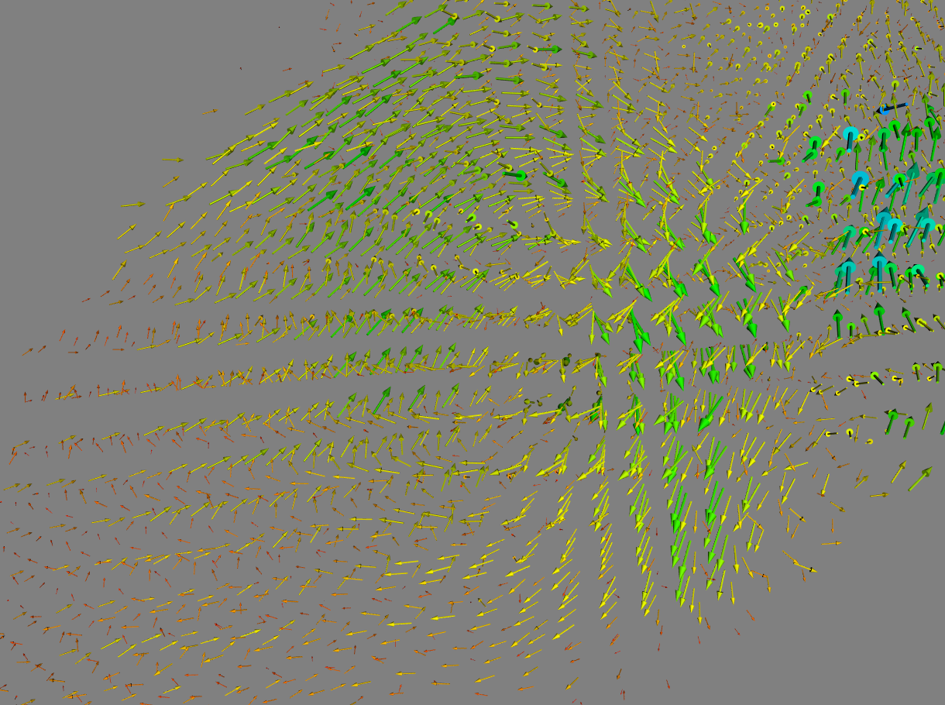
Masked Vector (LA_LV_volume.mat)

Slide 6
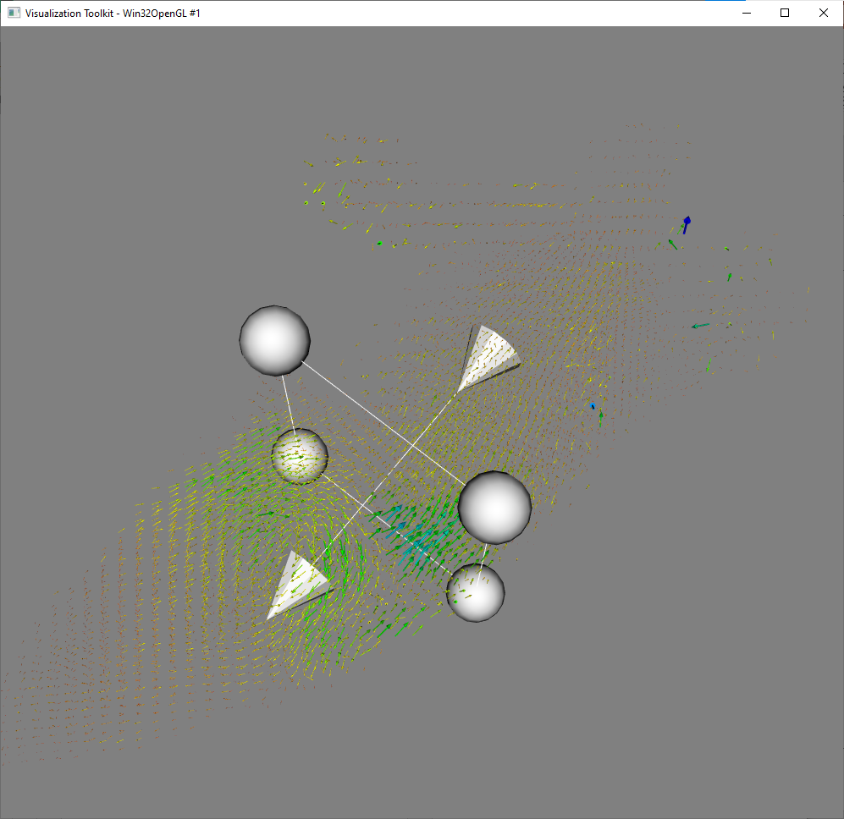
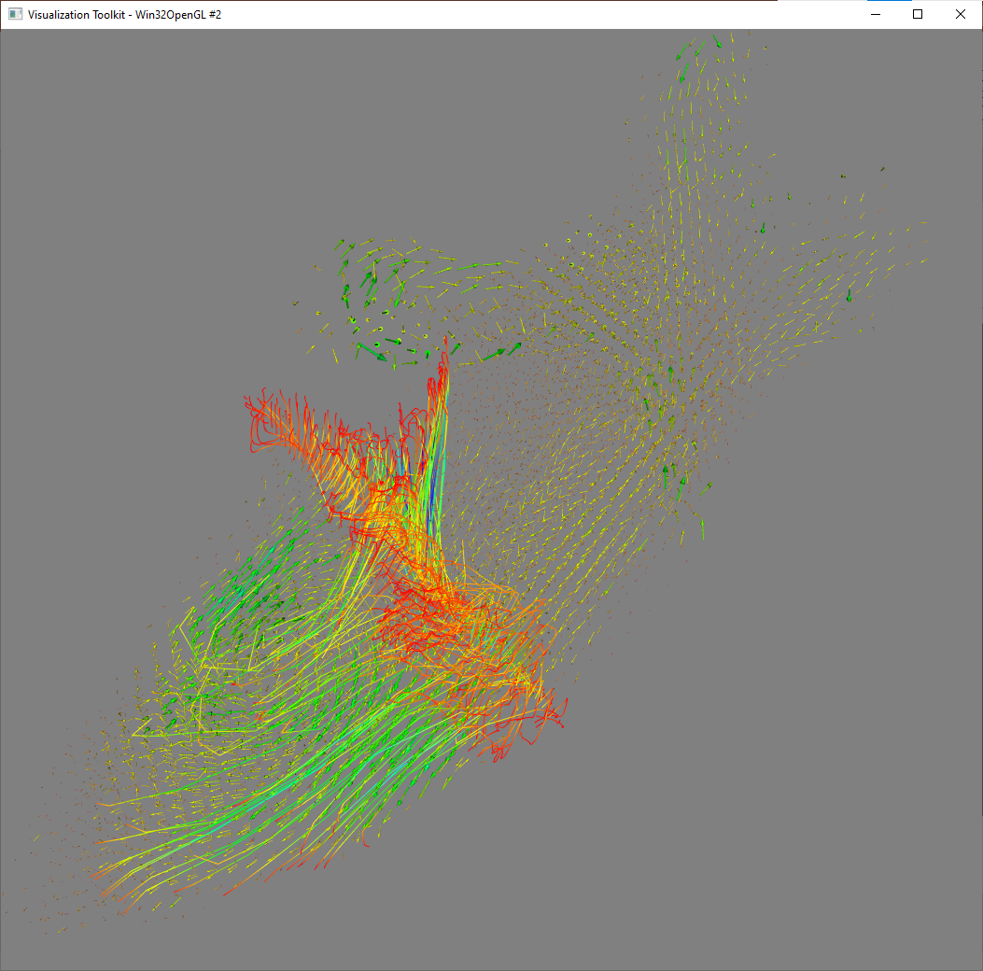
Plane Widget
Currently, input plane parameter manually.

Slide 7
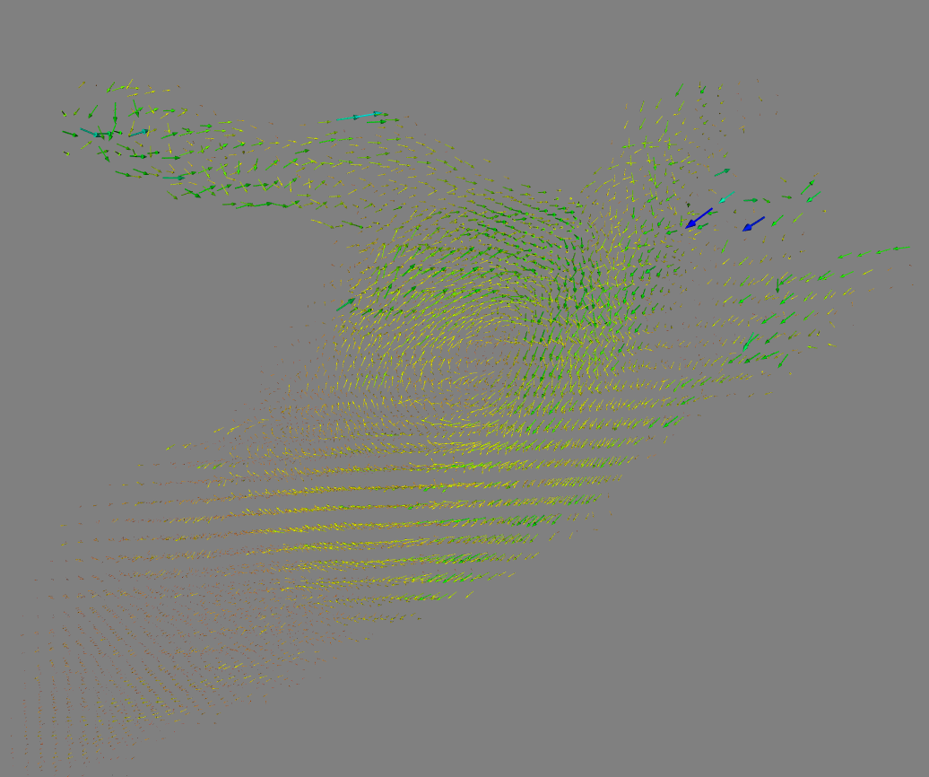
Vector Plot of specified phase
Phase 0
Phase 9

Slide 8
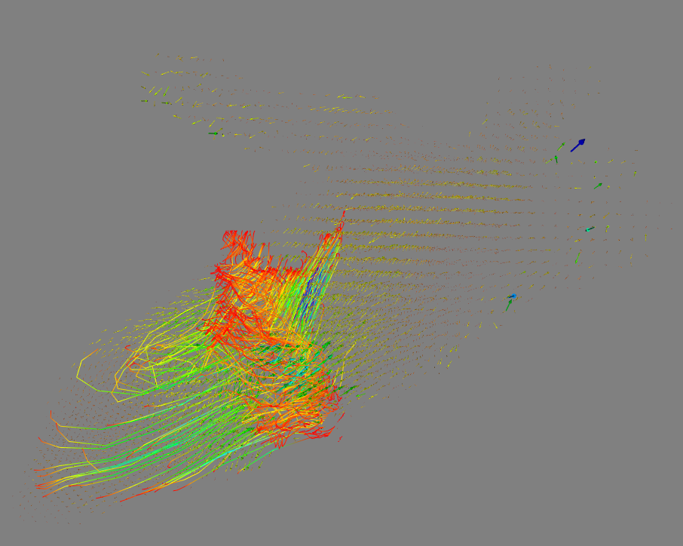
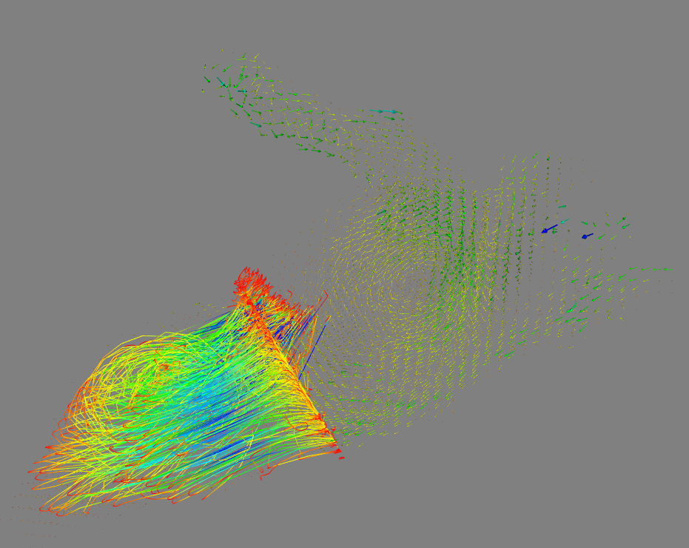
Pathline From Phase 9 to Phase 9
Start from Phase 0
Start from Phase 9

Slide 9
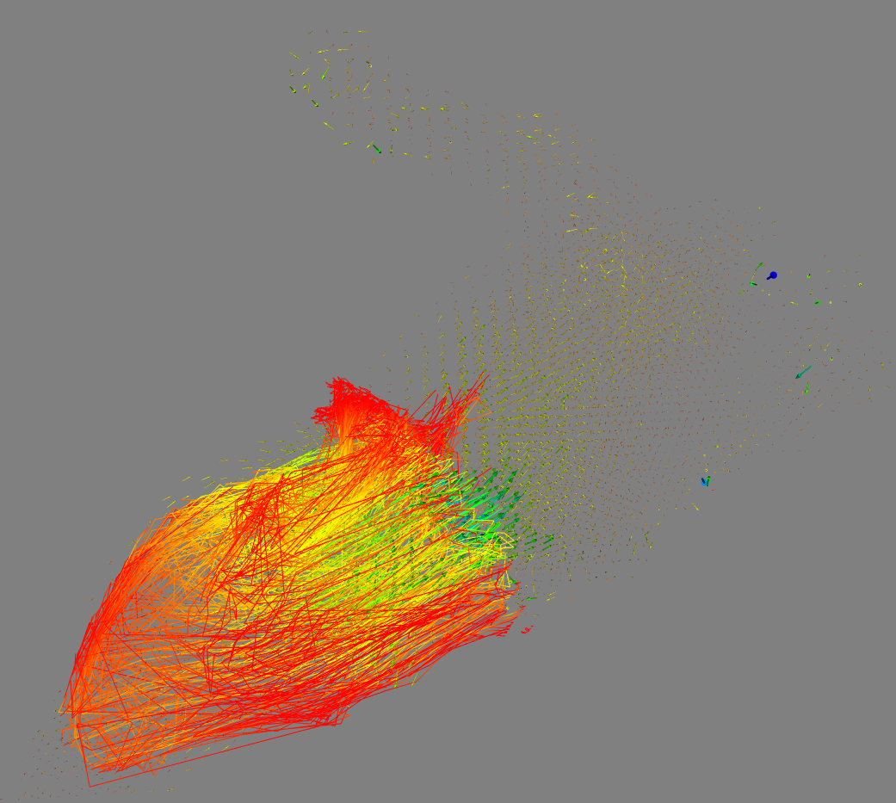
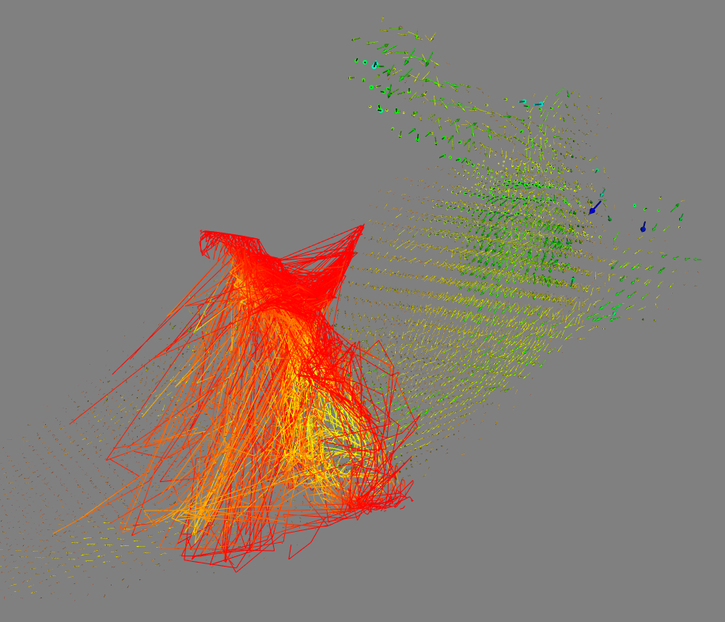
Streakline
Start from Phase 0
Start from Phase 9

Slide 10
Integrator
Calculated by Runge-Kutta 2
If Runge-Kutta 45 is used, warning occurs.
vtkRungeKutta45 (00000201BB40E450): Step size underflow. You must choose a larger tolerance or set the minimum step size to a larger value.
vtkRungeKutta2
Integrate an initial value problem using 2nd order Runge-Kutta method.
It uses a 2nd order Runge-Kutta method to obtain the values of a set of functions at the next time step.
vtkRungeKutta45
Integrate an initial value problem using 5th order Runge-Kutta method with adaptive stepsize control.
It uses a 5th order Runge-Kutta method with stepsize control to obtain the values of a set of functions at the next time step.
The stepsize is adjusted by calculating an estimated error using an embedded 4th order Runge-Kutta formula
Press, W. H. et al., 1992, Numerical Recipes in Fortran, Second Edition, Cambridge University Press Cash, J.R. and Karp, A.H. 1990, ACM Transactions on Mathematical Software, vol 16, pp 201-222

Slide 11
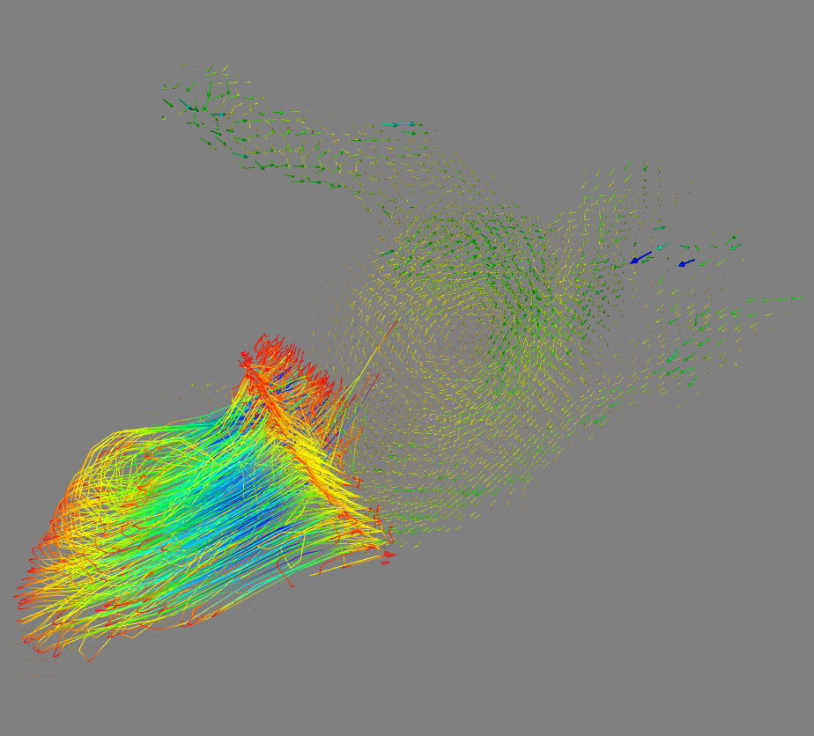
Integrator Algorithm comparison
Runge-Kutta 2
Runge-Kutta 45 (with warnings)

